Slide 1
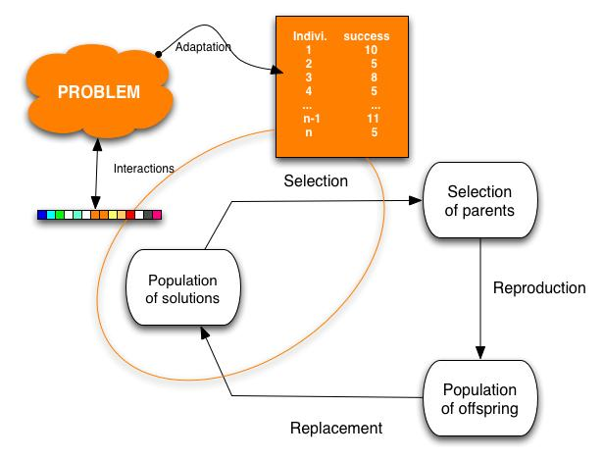
Genetic Algorithms
Variant of local beam search with sexual recombination.

Slide 2
Genetic Algorithms
GAs begin with a set of k randomly generated states, called the population.
Each state, or individual, is represented as a string over a finite alphabet—most commonly, a string of 0s and 1s.
For example, an 8-queens state must specify the positions of 8 queens, each in a column of 8 squares, and so requires 8 x log₂ 8 = 24 bits.
Alternatively, the state could be represented as 8 digits, each in the range from 1 to 8.
Figure 4.6(a) shows a population of four 8-digit strings representing 8-queens states.

Slide 3
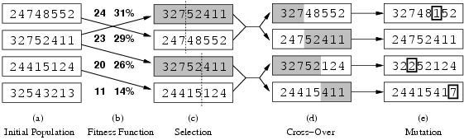
Genetic Algorithms
Figure 4.6: The three major operations in genetic algorithm. The initial population in (a) is ranked by the fitness function in (b), resulting in pairs for mating in (c). They produce offspring in (d), which are subject to mutation in (e).

Slide 4
Genetic Algorithms
The production of the next generation of states is shown in Figure 4.6(b)–(e).
In (b), each state is rated by the objective function, or (in GA terminology) the fitness function.
A fitness function should return higher values for better states, so, for the 8-queens problem we use the number of nonattacking pairs of queens, which has a value of 28 for a solution.
The values of the four states are 24, 23, 20, and 11.
In this particular variant of the genetic algorithm, the probability of being chosen for reproducing is directly proportional to the fitness score, and the percentages are shown next to the raw scores.

Slide 5
Genetic Algorithms
In (c), two pairs are selected at random for reproduction, in accordance with the probabilities in (b).
Notice that one individual is selected twice and one not at all.
For each pair to be mated, a crossover point is chosen randomly from the positions in the string.
In Figure 4.6, the crossover points are after the third digit in the first pair and after the fifth digit in the second pair.
In (d), the offspring themselves are created by crossing over the parent strings at the crossover point.
For example, the first child of the first pair gets the first three digits from the first parent and the remaining digits from the second parent, whereas the second child gets the first three digits from the second parent and the rest from the first parent.

Slide 6
Genetic Algorithms
The example shows that when two parent states are quite different, the crossover operation can produce a state that is a long way from either parent state.
It is often the case that the population is quite diverse early on in the process, so crossover (like simulated annealing) frequently takes large steps in the state space early in the search process and smaller steps later on when must individuals are quite similar.

Slide 7
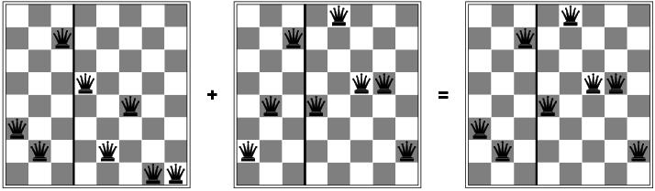
Genetic Algorithms
Finally, in (e), each location is subject to random mutation with a small independent probability.
One digit was mutated in the first, third, and fourth offspring.
In the 8-queens problem, this corresponds to choosing a queen at random and moving it to a random square in its column.
Md. Tarek Habib

Slide 8
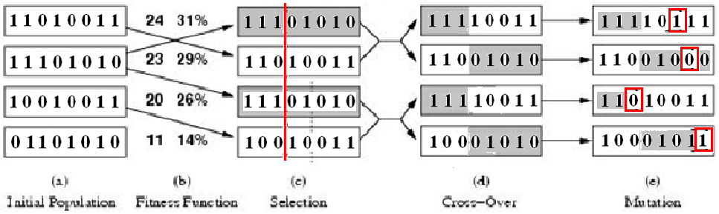
Genetic Algorithms
Figure: A genetic algorithm. The algorithm is the same as the one diagrammed in the figure in slide no. 45, with one variation: in this more popular version, each mating of two parents produces only one offspring, not two.

Slide 9
Genetic Algorithms
function GENETIC_ALGORITHM( population, FITNESS-FN) return an individual
input: population, a set of individuals
FITNESS-FN, a function which determines the quality of the individual
repeat
new_population ← empty set
loop for i from 1 to SIZE(population) do
x ← RANDOM_SELECTION(population, FITNESS_FN) y ← RANDOM_SELECTION(population, FITNESS_FN)
child ← REPRODUCE(x,y)
if (small random probability) then child ← MUTATE(child )
add child to new_population
population ← new_population
until some individual is fit enough or enough time has elapsed
return the best individual

